Slide 1
STOCK MARKET PREDICTION CHATBOT

Slide 2
TEAM MEMBERS:
AKHIL C JANARDHANAN
JIS MATHEW
JISHNU GOPI
NITHIN JOY JOSE
RAMESH KRISHNAN

Slide 3
PROBLEM STATEMENT:
The aim of the project is to create a forecasting technique to predict future stock returns based on past returns to construct a portfolio of multiple stocks in order to diversify the risk.
We do this by applying deep learning method of Long Short Term Memory for stock price forecasting by interpreting the seemingly chaotic market data.
A Chatbot via Textual Conversation which is computer programmed is adopted as the output solution for the problem.

Slide 4
STOCK MARKET??
Stock Market is a place where shares of publicly listed companies can trade under certain rules and regulations of Govt.
In India predominantly two kinds of stock exchanges:
NSE (National Stock Exchange):
Leading stock Exchange in India located in Mumbai.
NIFTY is the index for NSE and it is based on the valuation of 50 top companies from different sectors.
In NSE there is trading of equity shares, bonds and government securities.

Slide 5
BSE (Bombay Stock Exchange):
SENSEX is the index for BSE and it is basically the valuation of 30 top companies from different sectors.
First Stock Exchange in the country to obtain permanent recognition in 1956.
Oldest Stock Exchange in Asia with a rich Heritage.
Established in 1875 with speed of 6 microseconds and one of india leading exchange groups.

Slide 6
CONCEPT:
Stock Market Prediction is the act of trying to determine the future value of a company stock or other financial instrument traded on an exchange.
The successful prediction of a stock's future price could yield significant profit. The efficient-market hypothesis suggests that stock prices reflect all currently available information and any price changes that are not based on newly revealed information thus are inherently unpredictable.
Others disagree and those with this viewpoint possess myriad methods and technologies which purportedly allow them to gain future price information.

Slide 7
MOTIVATION:
The fluctuation of stock market is violent and there are many complicated financial indicators. However, the advancement in technology, provides an opportunity to gain steady fortune from stock market and also can help experts to find out the most informative indicators to make better prediction.
The prediction of the market value is of paramount importance to help in maximizing the profit of stock option purchase while keeping the risk low.

Slide 8
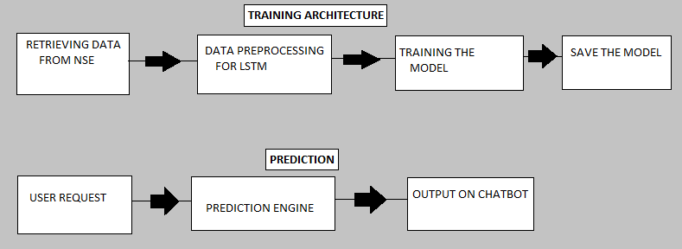
FLOWCHART:

Slide 9
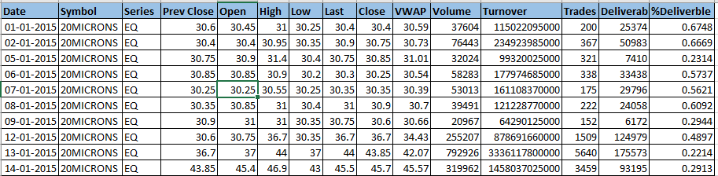
DATASET:

Slide 10
Dataset is retrieved from NSEPY python package.
There are 1758 companies details from 2015 to July 2019.
There are 16 lakhs rows and 15 columns in the dataset.
The columns Open and Close represent the starting and final price at which the stock is traded on a particular day.
High , Low and Last represent the maximum, minimum, and last price of the share for the day.
Total Trade Quantity is the number of shares bought or sold in the day and Turnover is the turnover of the particular company on a given date.
The Close Column is taken as the target column for prediction.

Slide 11
LONG SHORT TERM MEMORY (LSTM):
LSTM networks are well-suited to classifying, processing and making predictions based on time series data, since there can be lags of unknown duration between important events in a time series.
A RNN using LSTM units can be trained in a supervised fashion, on a set of training sequences, using an optimization algorithm, like Gradient Descent combined with back propagation through time to compute the gradients needed during the optimization process, in order to change each weight of the LSTM network in proportion to the derivative of the error (at the output layer of the LSTM network) with respect to corresponding weight.

Slide 12
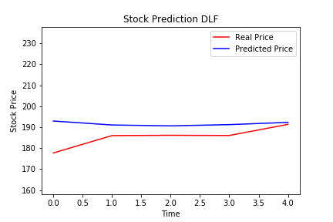
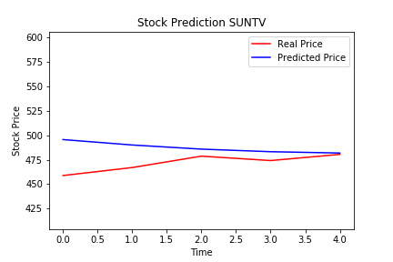
RESULT(LSTM):
RMSE = 17.49849
PER ERROR =9.435693
RMSE = 44.88425
PER ERROR = 9.513003

Slide 13
ELISA AS CHATBOT:
Chatbots are increasingly present in businesses and often are used to automate tasks that do not require skill-based talents.
With customer service taking place via messaging apps as well as phone calls, there are growing numbers of use-cases where chatbot deployment gives organisations a clear return on investment.
Call centre workers may be particularly at risk from AI-driven chatbots.
Chatbot techniques, concepts, tools we used are:
Natural Language Processing (NLTK)
Pattern Matching
Bag Of Words

Slide 14
Twitter Sentiment Score as new feature:
Social media plays important role in predicting the stock market return values. So, we then appended our data with one more feature .
Twitter’s Daily Sentiment Score for each company based upon the user’s tweets about that particular company and also the tweets on that company’s page.
Once we were ready with complete set of features, we normalized our data for better results.

Slide 15
OUTPUT

Slide 16


Slide 17
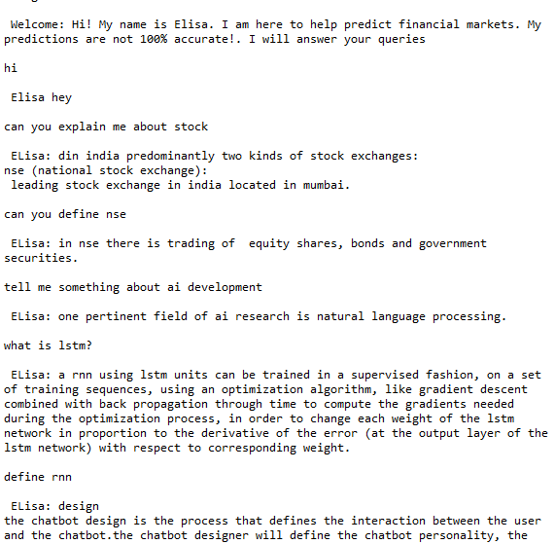
Queries

Slide 18
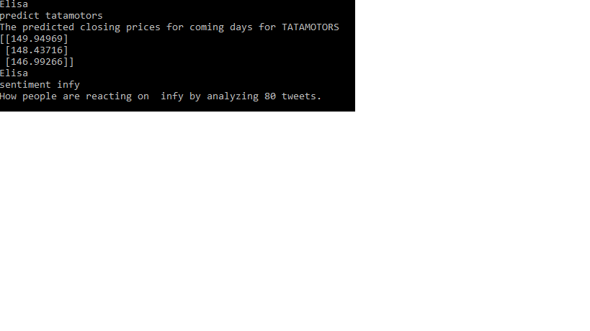
Predicted price

Slide 19
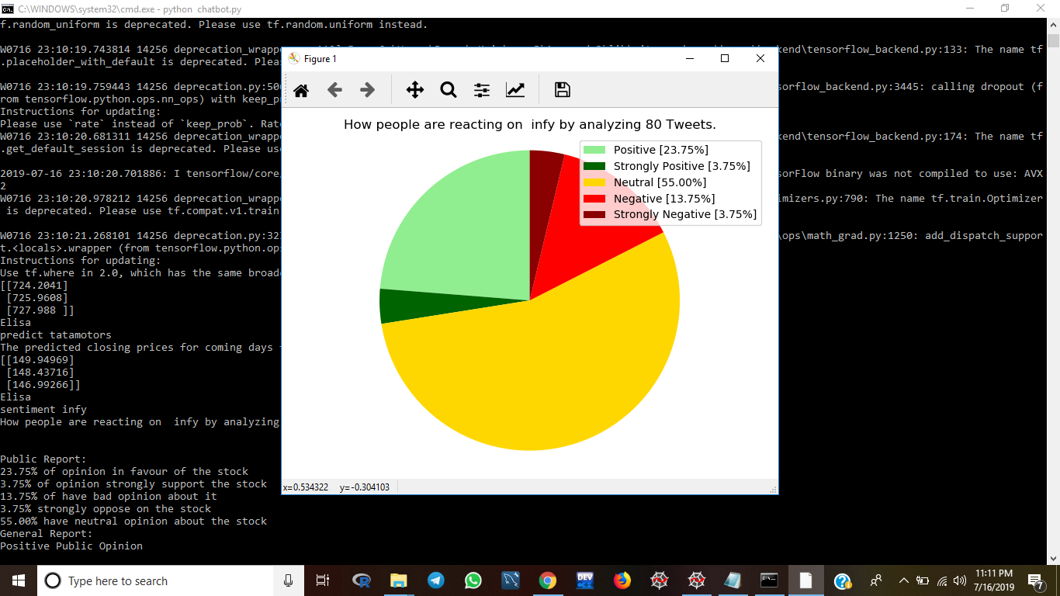
Feelings about the company

Slide 20
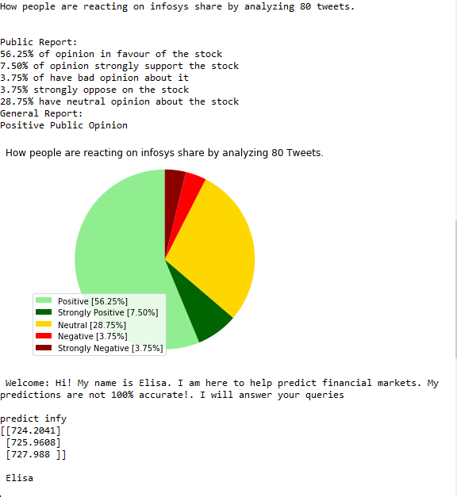

Slide 21
CHALLENGES:
As stock prices behave differently, stock prediction accuracy will also vary. As much as you challenge it, some data sets are better to work with than others.
The current model is narrow in scope and does not factor in implications of macroeconomic indicators such as Real GDP, inflation, or interest rates which can have drastic effects on some stocks.
Our results suggest that the use of character level embeddings is promising and competitive with more complex models which use technical indicators and event extraction methods in addition to the news articles.

Slide 22
FUTURE SCOPE:
Combination of many independent base learners will significantly decrease the error. Therefore we want to produce as many independent base learners as possible.
Future study and implementation of economic growth model for stock market prediction and the analysis of how economic growth model will affect in stock market prediction is tentatively good scope.
We can apply our methods to other sectors such as healthcare, retail, service, etc. We can also apply our methods to mid-size and startup companies, to see how the size of a company affects our model’s predictive ability.

Slide 23
Caution
**In the light of the risks involved, you should undertake stock market investments only if you understand the nature of the relationship into which you are entering and the extent of your exposure to risk.**

Slide 24
THANKYOU

